Slide 1
Bid-Hit
THE AUCTION WEBSITE

Slide 2
Developed By :-
Under The Supervision Of :-
Abhay Kumar
Aryan Tiwari
Amish Gupta
Karan Mishra
Nikhil Agarwal
Mr. Mandeep Singh (Technical Trainer, GLA University)

Slide 3
Sign Up Page
If the user is a new user, the he/she must have to sign up on this page by accepting the terms and conditions.
After the registration, the data of new user will be updated on firebase.

Slide 4
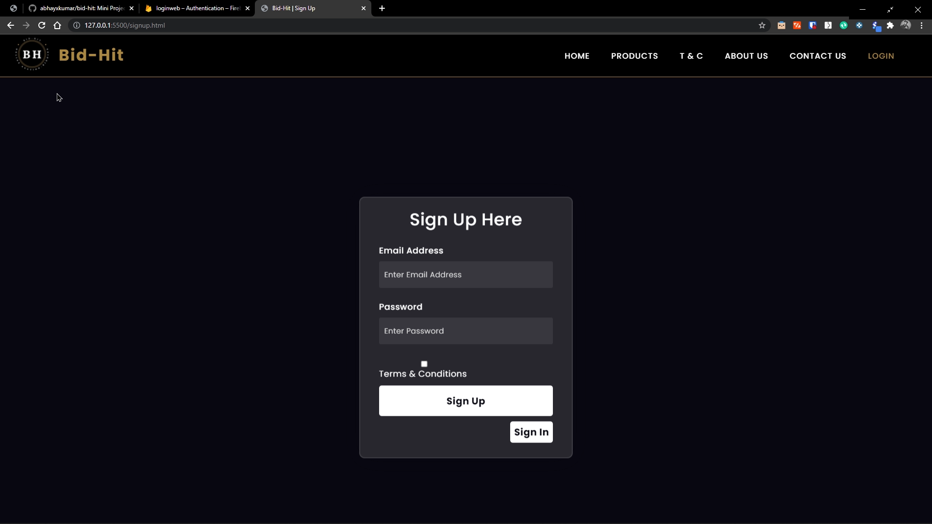
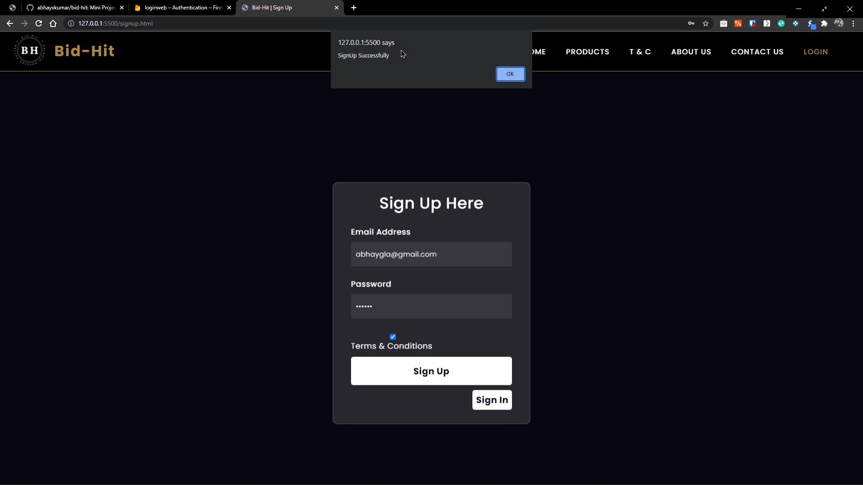

Slide 5
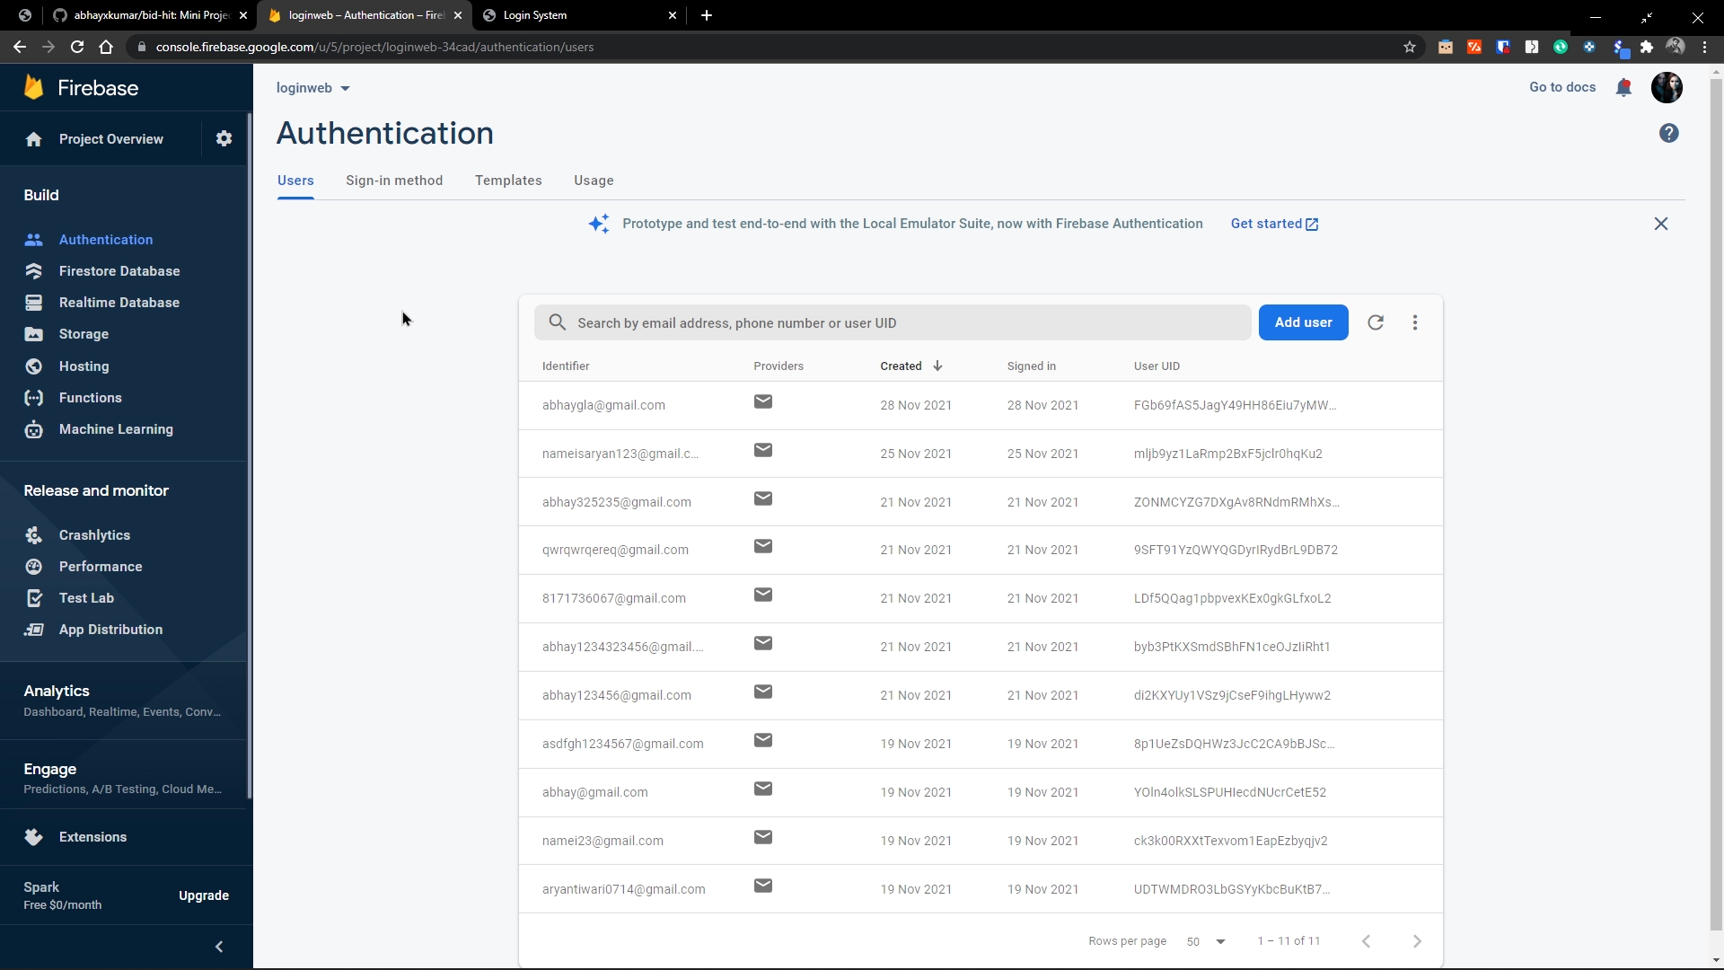

Slide 6
Sign In Page
If the user is a registered user, the he/she must have to sign in on this page, and after clicking on the sign in button, the user will be directed on the Home page.

Slide 7
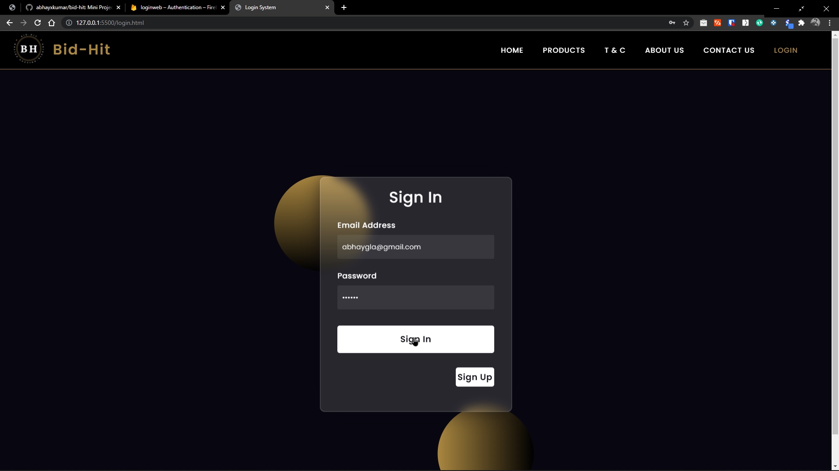

Slide 8
Home Page
On the Home page, the user will get many options on the navbar of the site. From where the user can get various option to visit.
And also on scrolling down, the user can subscribe on our site for latest updates. When the user will subscribe, its subscription will be stored on the firebase.
On clicking on “More Reviews” user can get the reviews from our costumers.

Slide 9
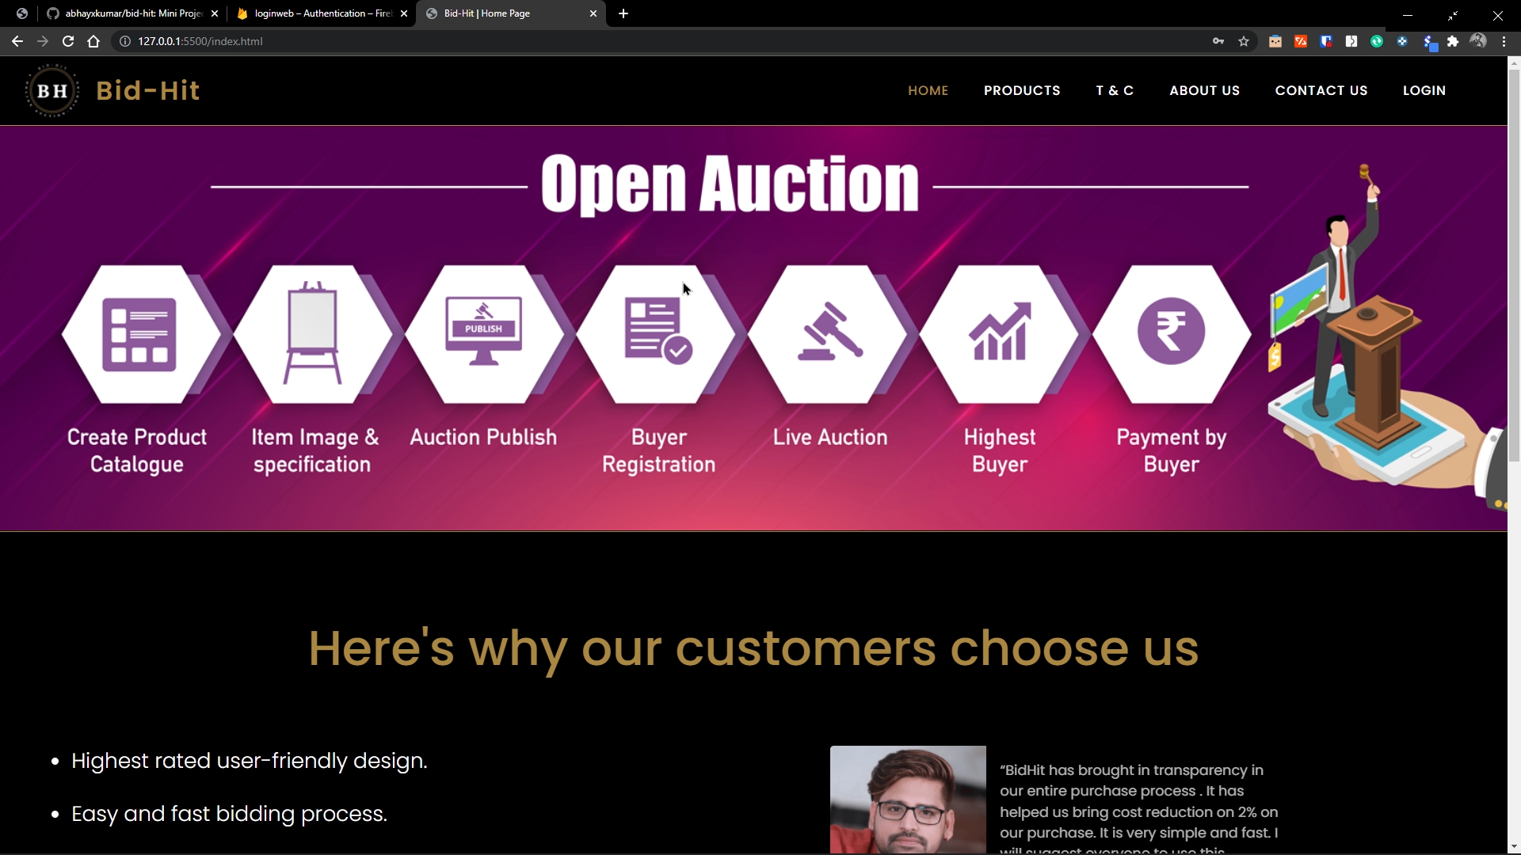

Slide 10
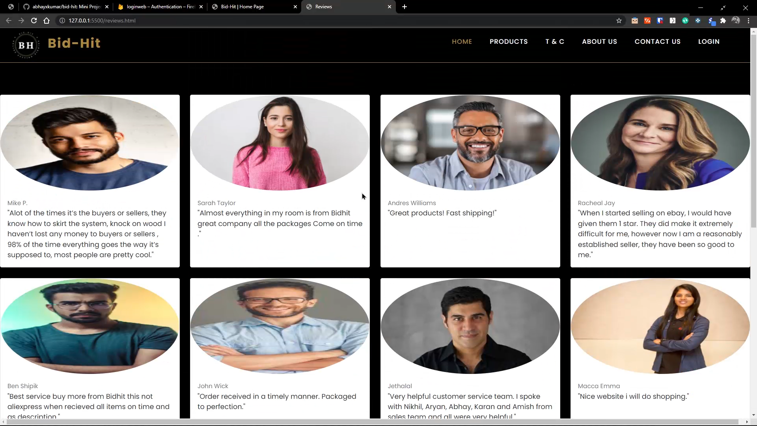

Slide 11
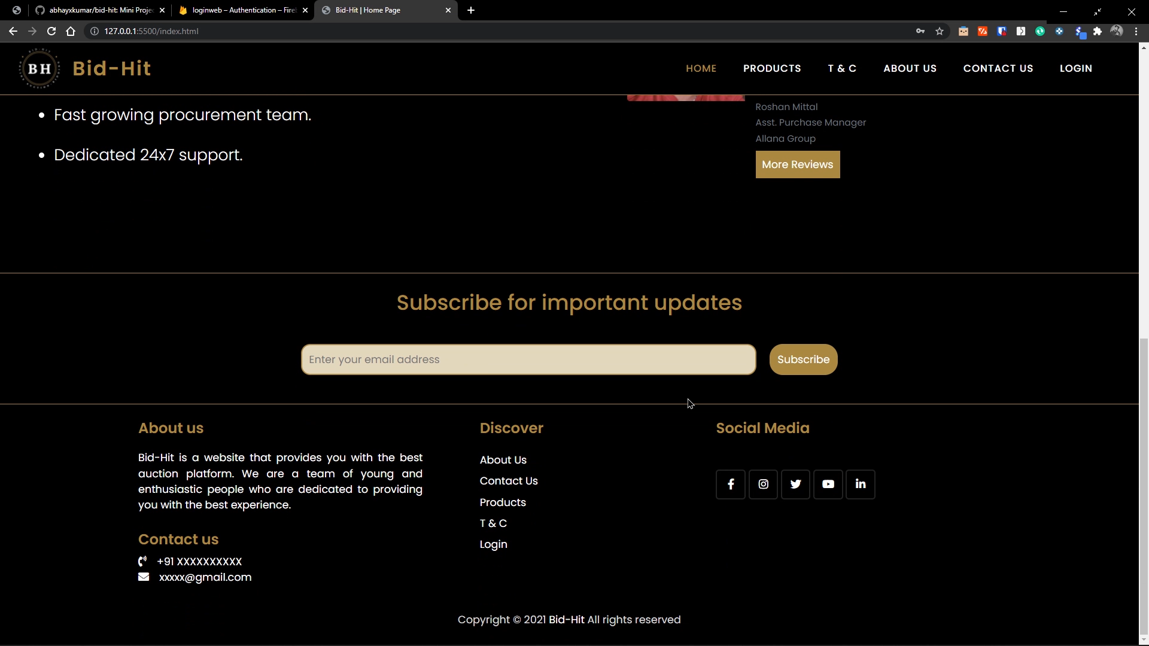

Slide 12
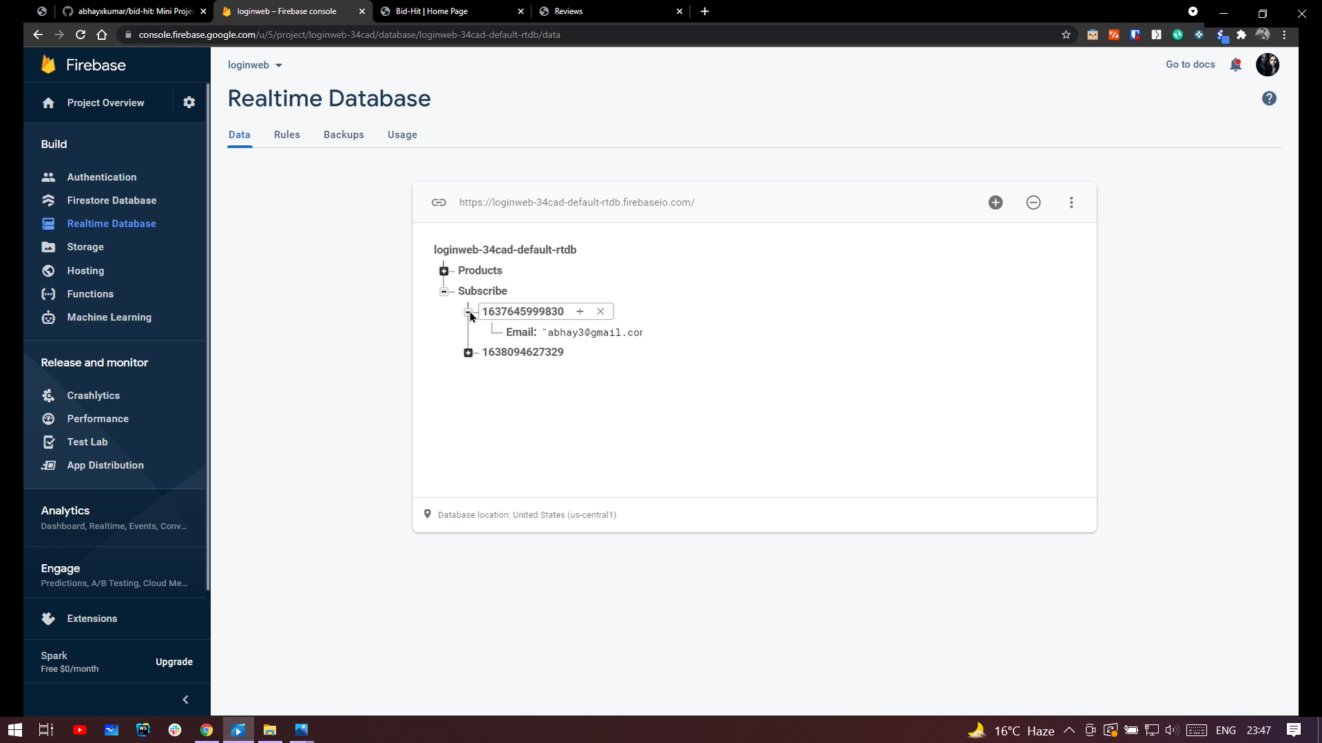

Slide 13
Terms & Conditions
Here, the user can get all the terms and conditions for the bidding process, and many more.

Slide 14
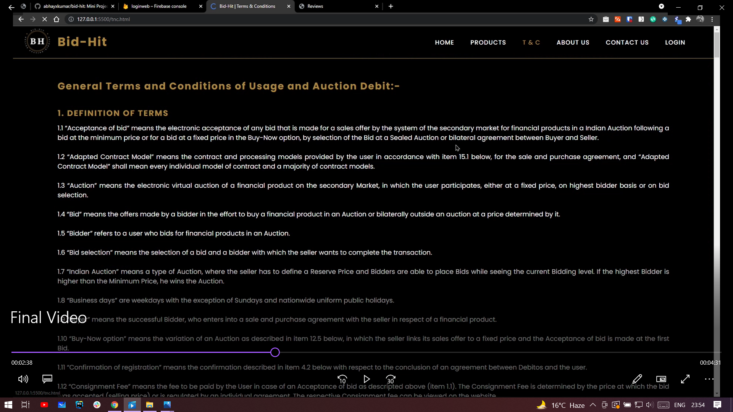
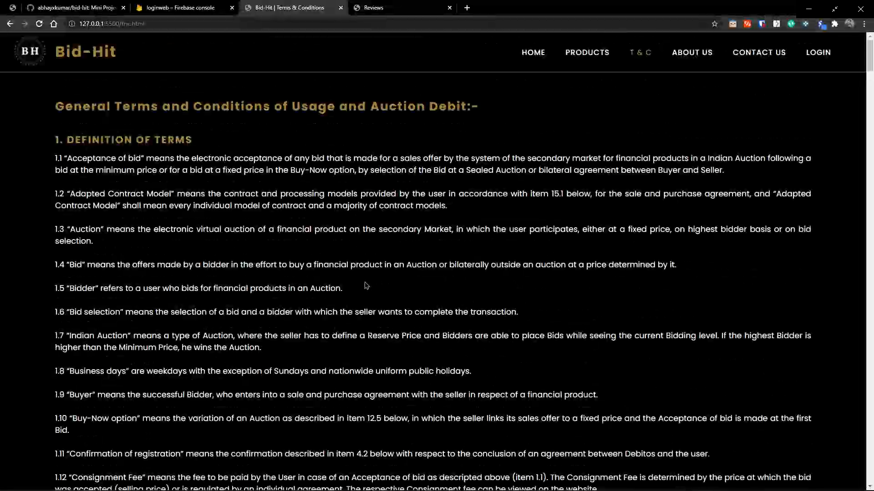

Slide 15
About Us Page
In this page, the user can get all the knowledge about our website (Bid-Hit) and also of our developers.

Slide 16
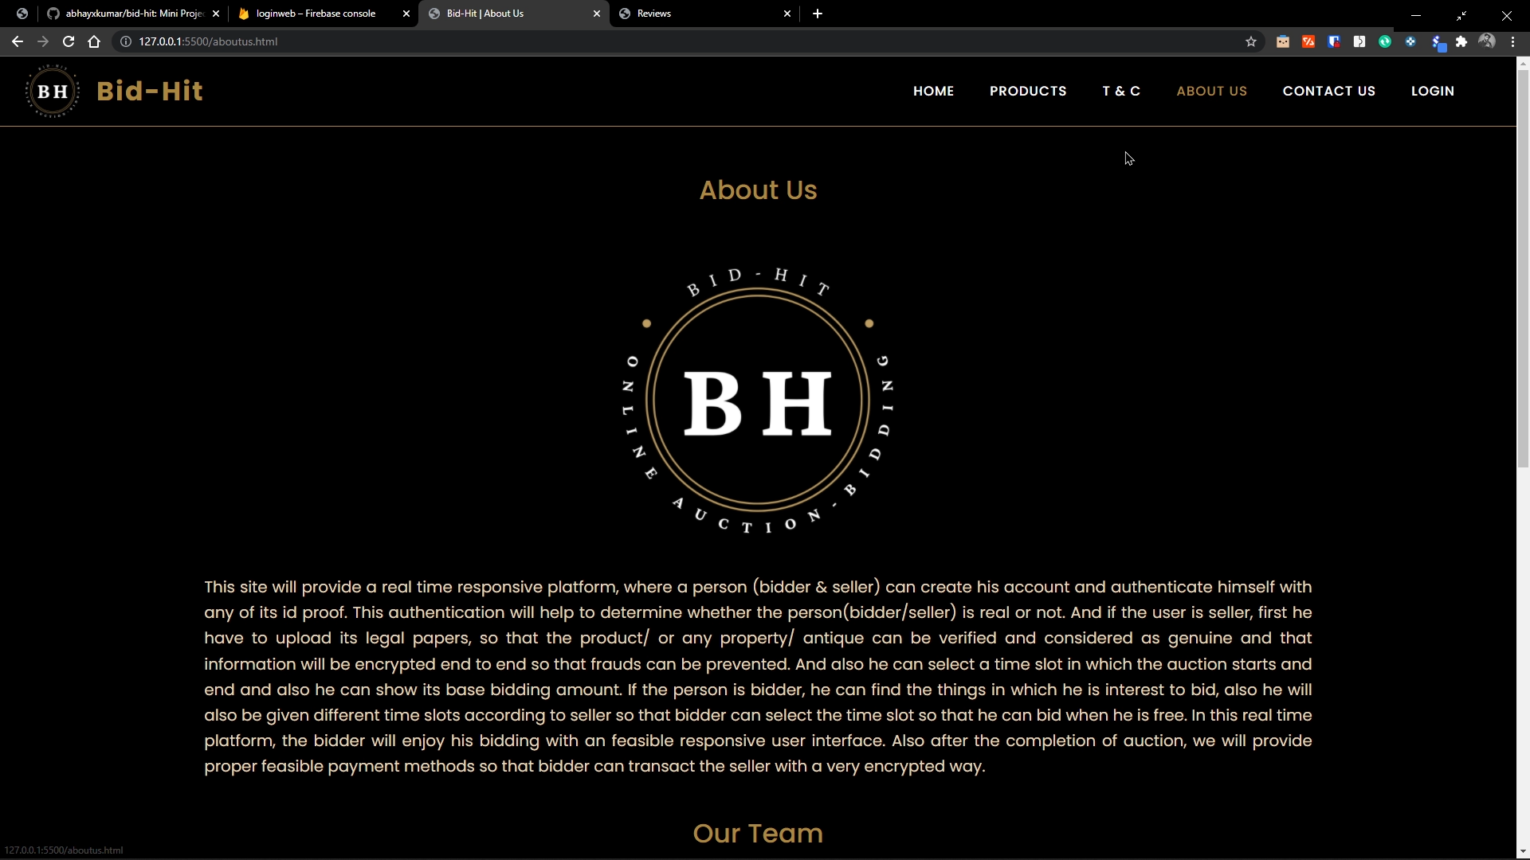

Slide 17
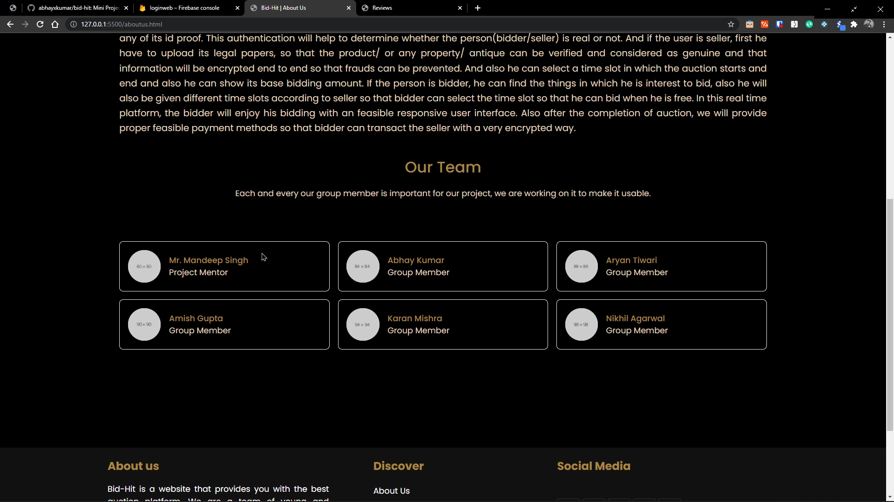

Slide 18
Contact Us Page
Here, the user can contact to our developers, through his email address. And his query will get into the firebase.

Slide 19
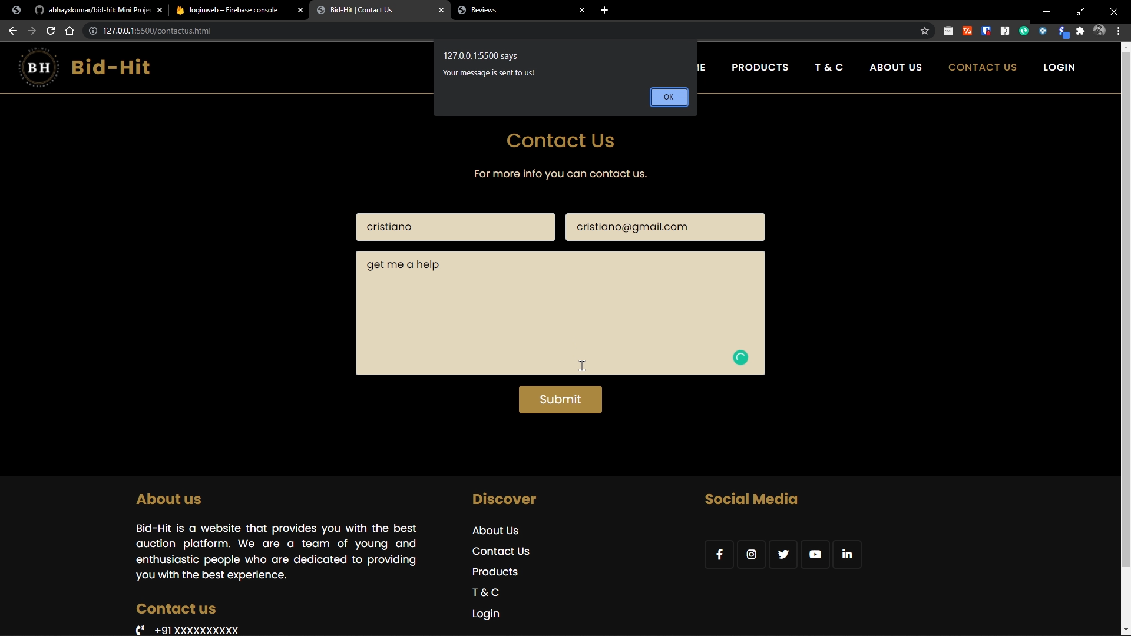

Slide 20
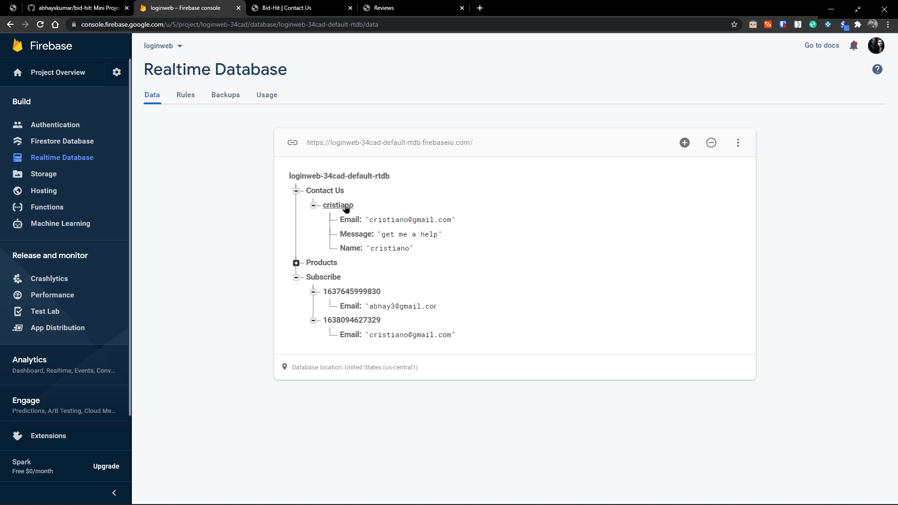

Slide 21
Products Page
Here, the user can see get some of the antiques and can bid on any of the antique of his choice. But the he can only bid, if the bidding time has been started, if the bidding time is not started, the user can not bid.

Slide 22
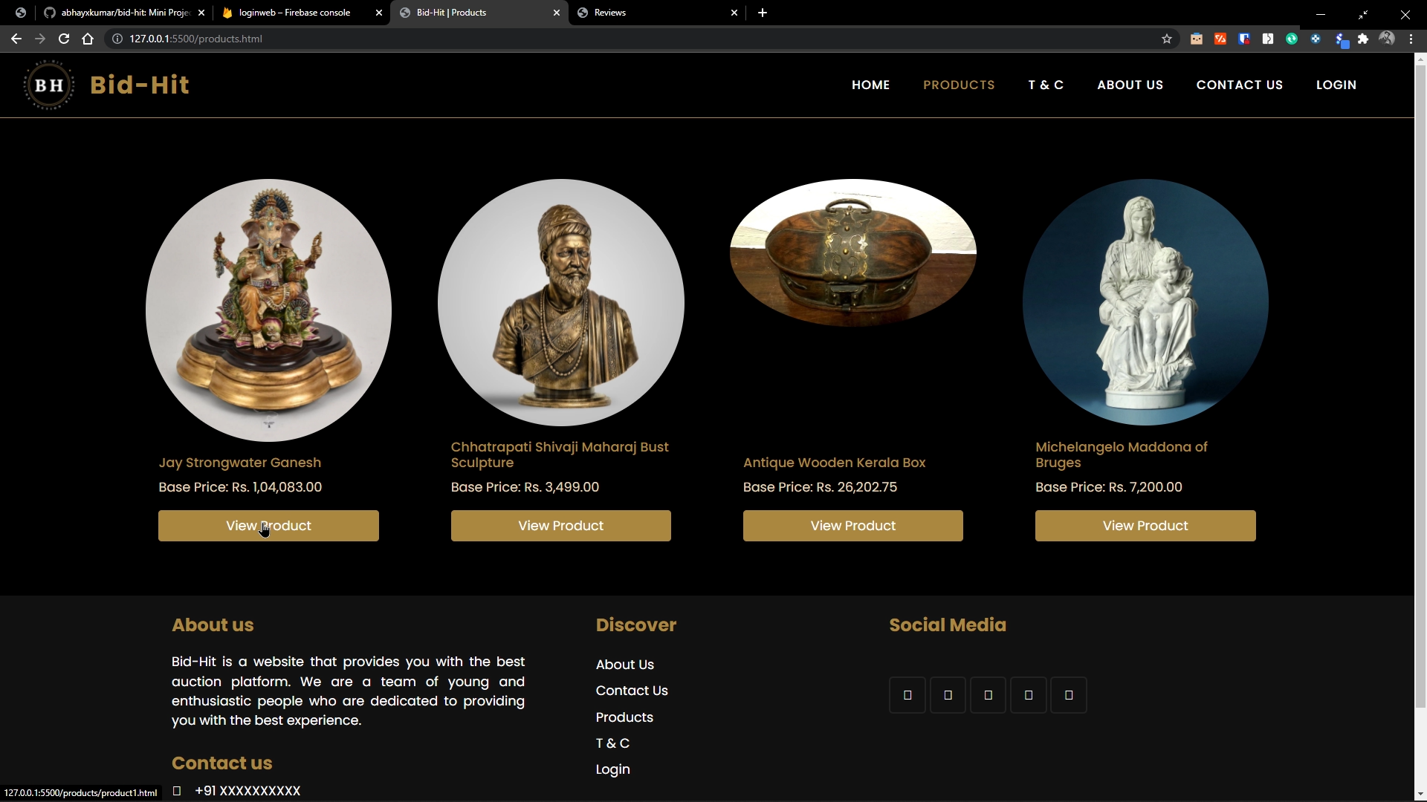


Slide 23
If Bidding is closed -
If the bidding is closed, the user will receive a pop-up(bidding is closed). Then the user must have to wait till the opening time of the bidding, till that he cannot bid, as the ‘bid now’ button will remain disable.

Slide 24


Slide 25
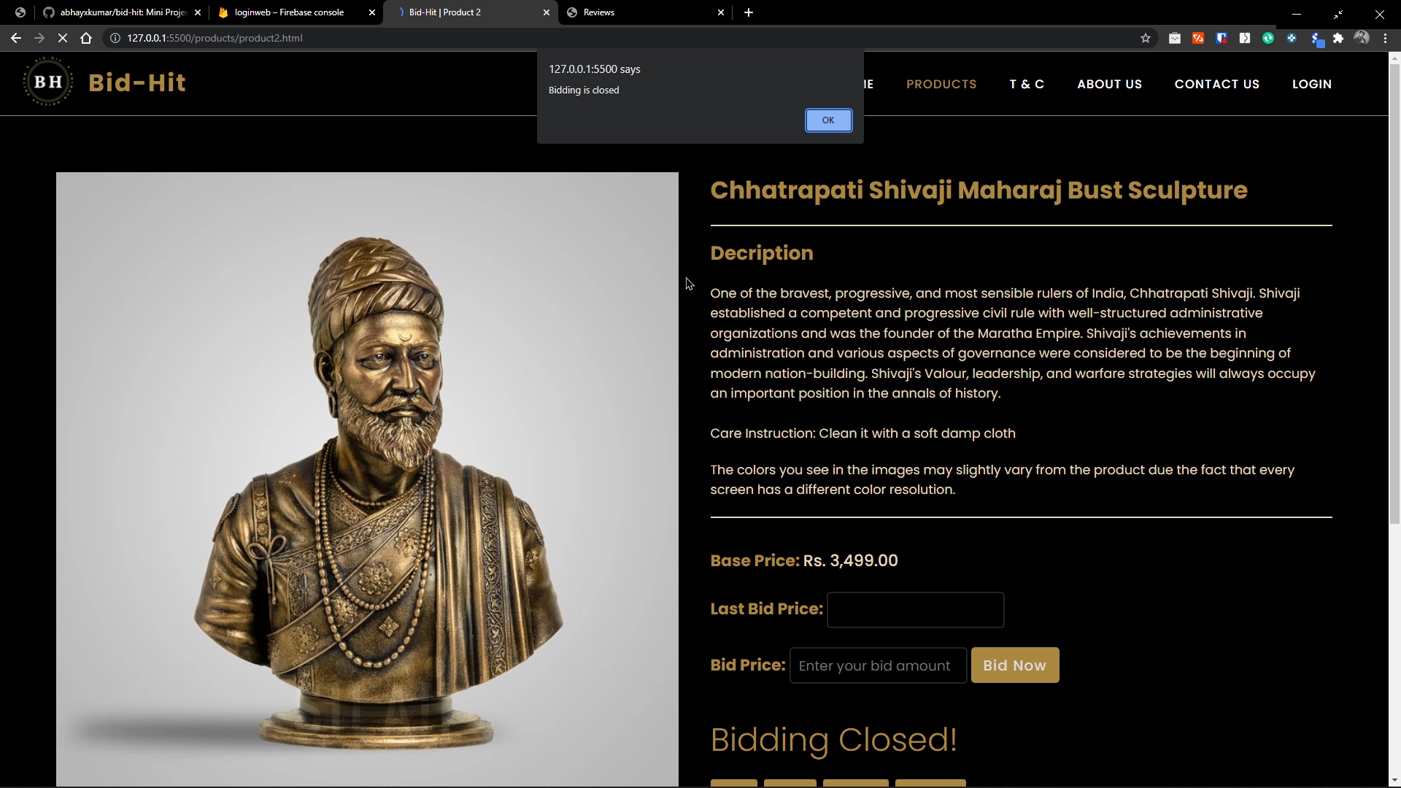

Slide 26
If Bidding is open -
If the bidding is open, the user will receive a pop-up(bidding is open). Then the user can bid on that product as the ‘bid now’ will remain enable untill the bidding gets end.
During the opening time the user can bid by entering his amount, if the amout entered will be greater than the last bid price, the bid price will be updated.
After the successfull completion of bidding, the bid now button will get disable and the payment option will come where user can pay the bidding amount.

Slide 28
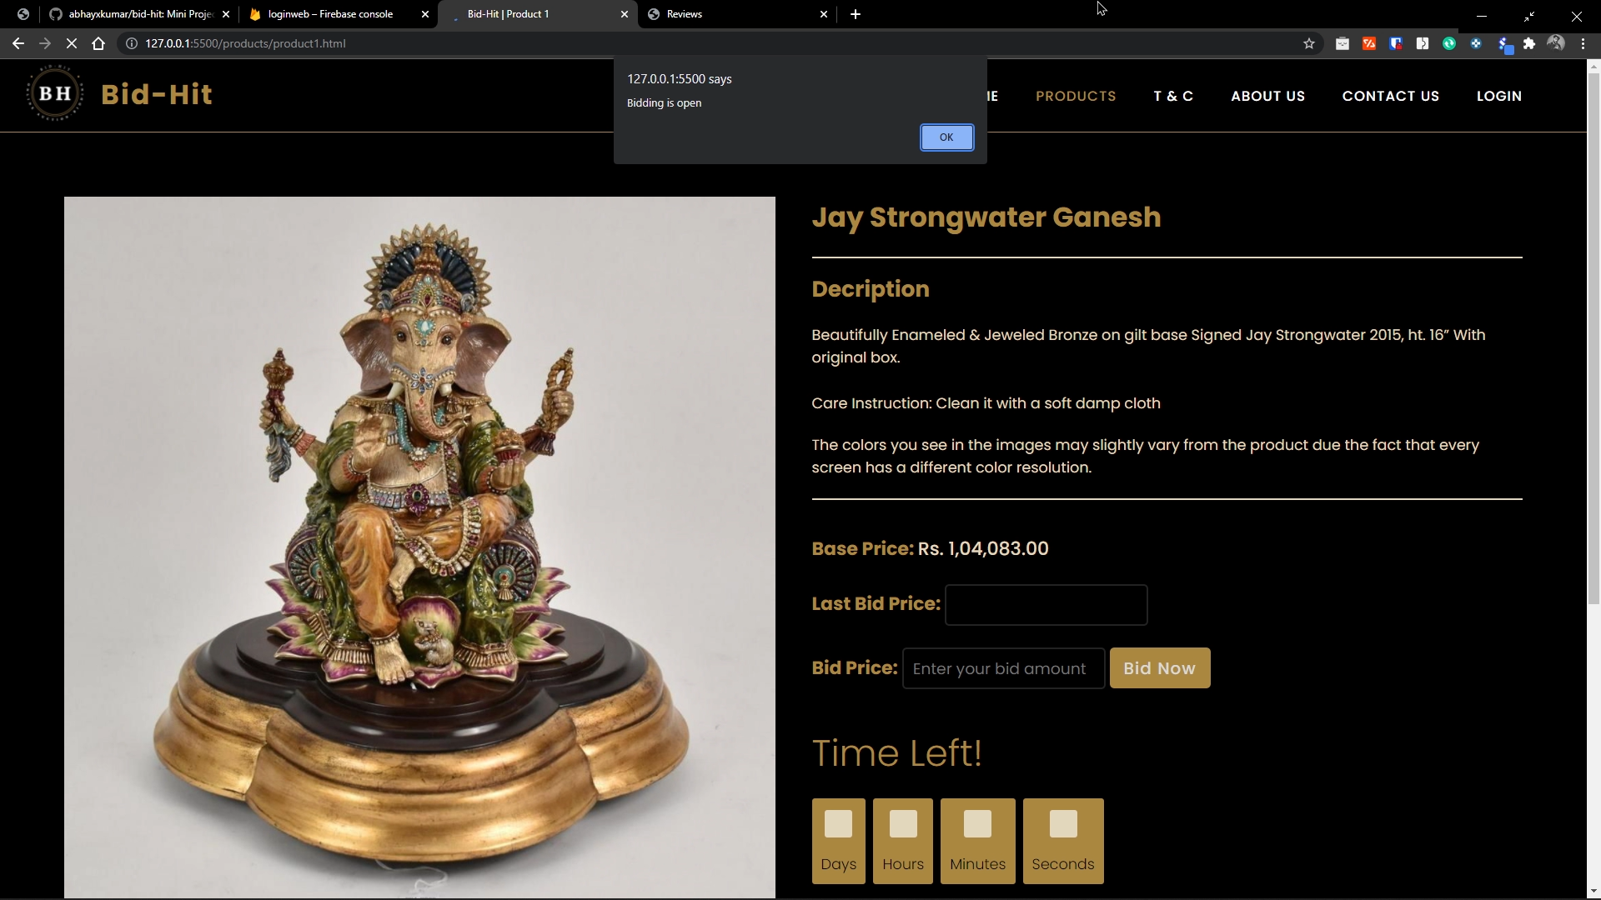

Slide 29
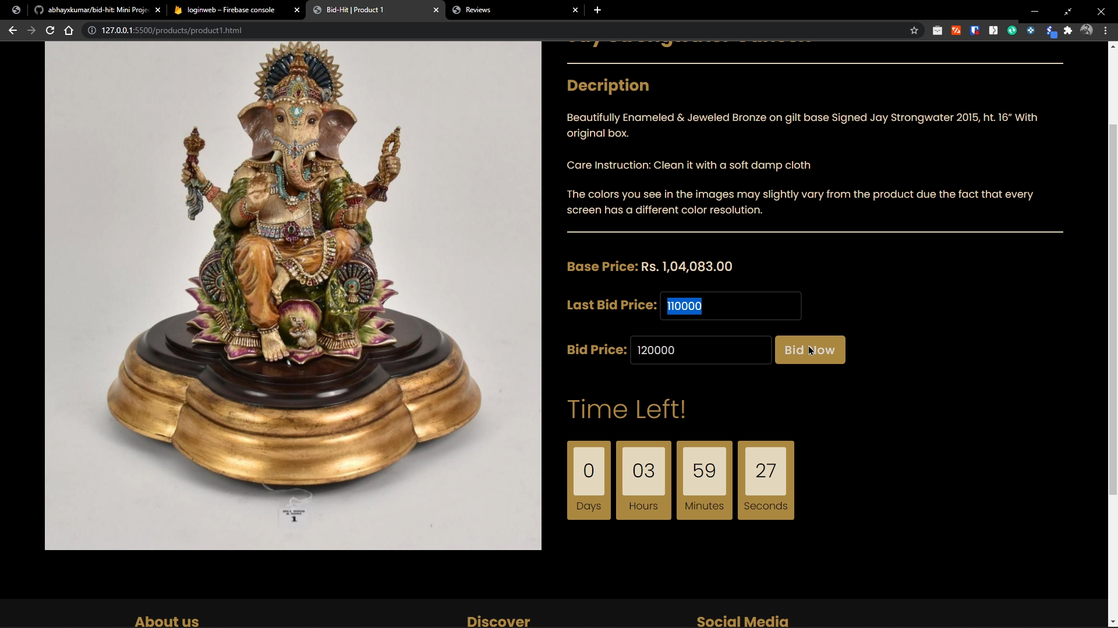

Slide 30


Slide 31
Thank You
Team Bid-Hit

